Slide 1

FfDL - Fabric for Deep Learning — Nick Acosta Developer Advocate

Slide 2
Agenda
Part One - Introduction 02
Agenda 03
Part Two - Deep Learning 10
AI / ML / DL 12
Neural Networks 13
Why Deep Learning 14
Why GPUs
Deep Learning Frameworks 16
Part Three - Watson Studio 23
Introducing Watson Studio 21
Architecture 22
Deep Learning as a Service
Part Four - Fabric for Deep Learning 04
Introduction 05
Characteristics 06
Architecture 07
Part Five - DLaaS Example 30
Part Six - Conclusion 31
Q&A 32

Slide 3
Deep Learning

Slide 4
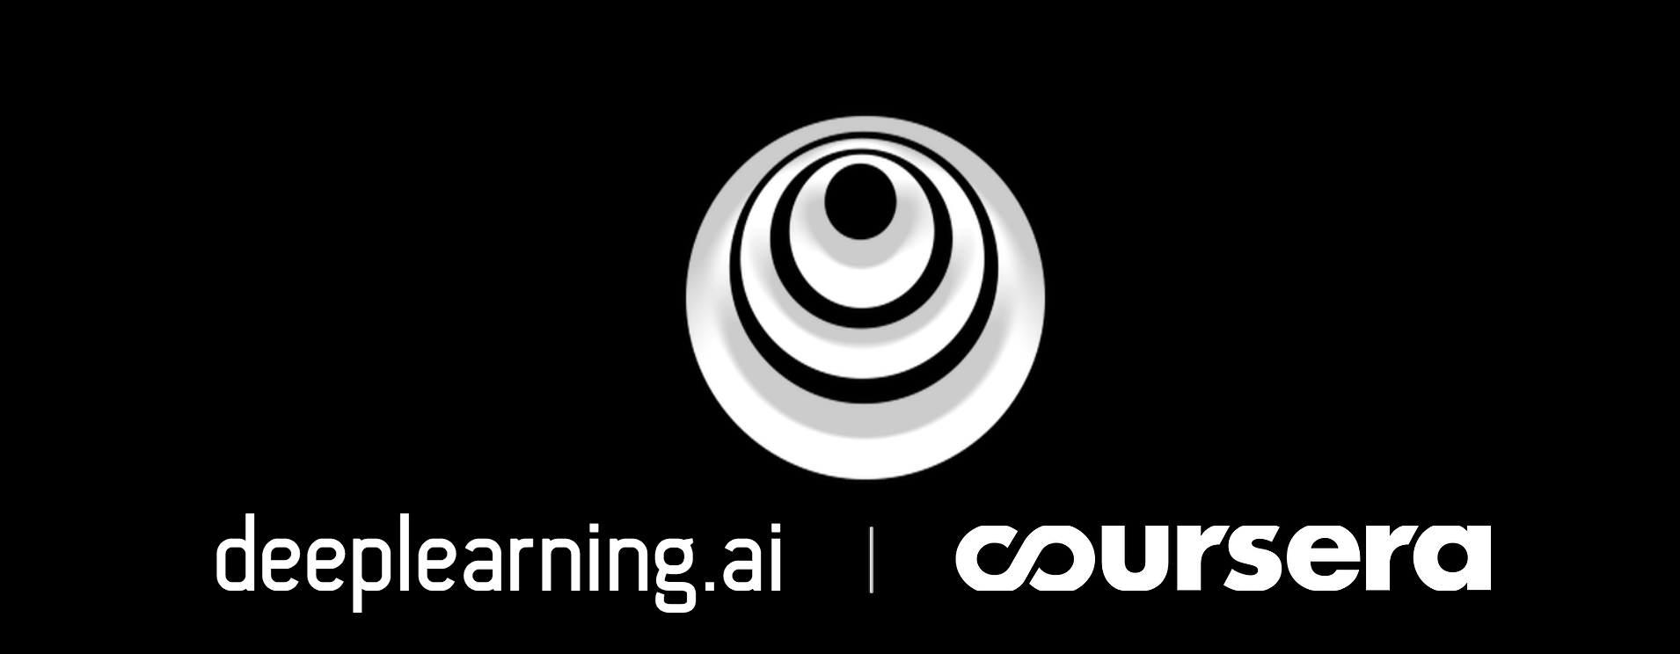
Deep Learning Resources

Slide 5
AI / ML / DL
Artificial Intelligence
Machine Learning
Deep Learning

Slide 6
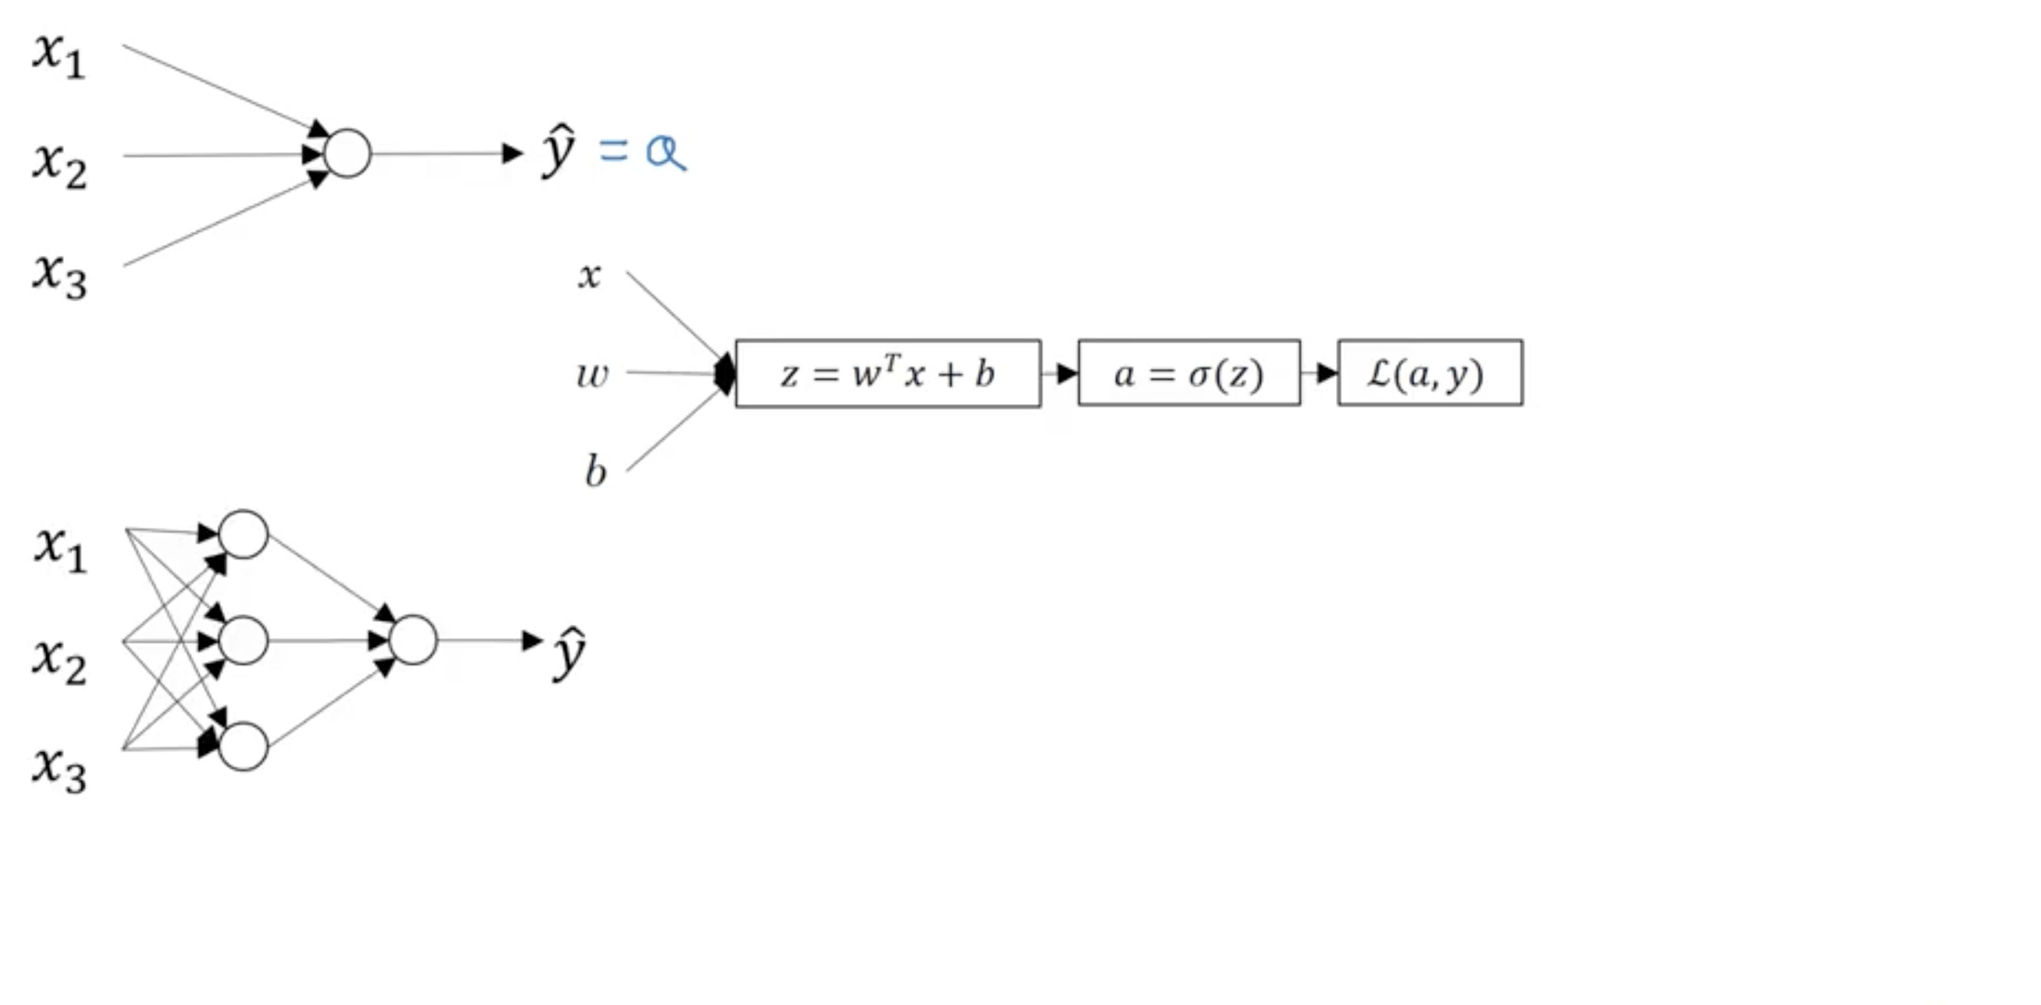
Neural Networks

Slide 7
Why Deep Learning?

Slide 8
Why GPUs?

Slide 9
Why GPUs?

Slide 10
Why GPUs?

Slide 11
Deep Learning Frameworks

Slide 12
TensorFlow / Keras

Slide 13
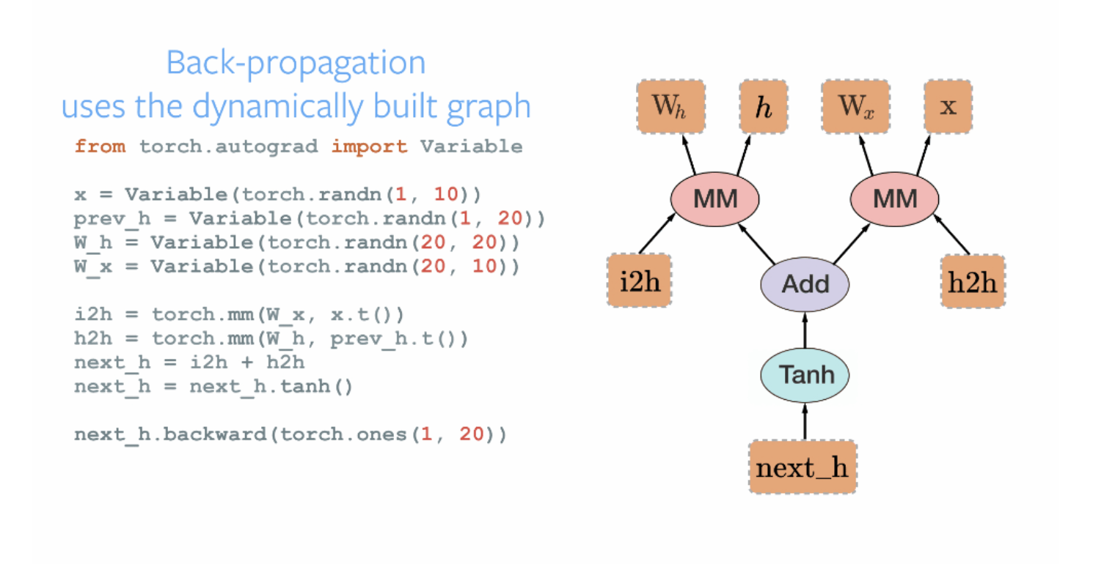
PyTorch

Slide 14
Deep Learning Resources

Slide 15
Watson Studio

Slide 16
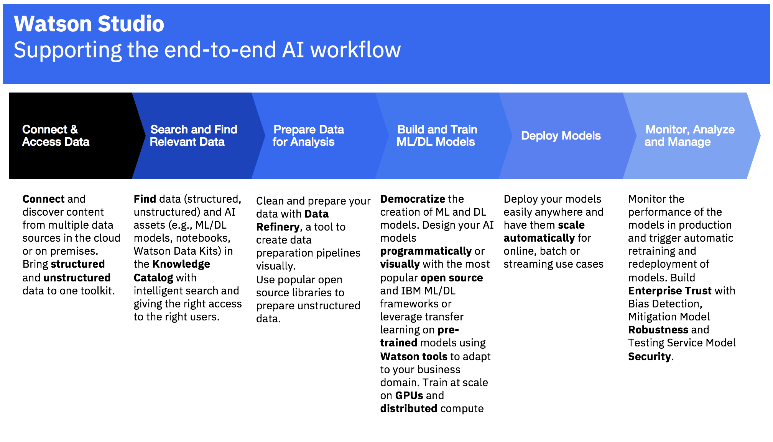

Slide 17
Connect & Access Data
The default storage type in Watson Studio is IBM Cloud Object Storage, although other object stores (AWS EMR) and data stores are compatible.

Slide 18
Connect & Access Data
The default storage type in Watson Studio is IBM Cloud Object Storage, although other object stores (AWS EMR) and data stores are compatible.
Prepare Data for Analysis
With GUI-based Data Refinery or in a variety of hosted programming languages in a Jupyter Notebook environment preconfigured for data science.

Slide 19
Connect & Access Data
The default storage type in Watson Studio is IBM Cloud Object Storage, although other object stores (AWS EMR) and data stores are compatible.
Prepare Data for Analysis
With GUI-based Data Refinery or in a variety of hosted programming languages in a Jupyter Notebook environment preconfigured for data science.
Machine Learning
Deep Learning
Build and Train ML/DL Models
Utilizing numerous open source machine learning and deep learning frameworks with the help of automated code in the form of a Experiment Assistant.

Slide 20
Connect & Access Data
The default storage type in Watson Studio is IBM Cloud Object Storage, although other object stores (AWS EMR) and data stores are compatible.
Prepare Data for Analysis
With GUI-based Data Refinery or in a variety of hosted programming languages in a Jupyter Notebook environment preconfigured for data science.
Machine Learning {}
Deep Learning {}
Build and Train ML/DL Models
Utilizing numerous open source machine learning and deep learning frameworks with the help of automated code in the form of a Experiment Assistant.
Deploy Models
At scale to serve predictions for non Data Scientists by utilizing consumable APIs

Slide 21
Connect & Access Data
The default storage type in Watson Studio is IBM Cloud Object Storage, although other object stores (AWS EMR) and data stores are compatible.
Prepare Data for Analysis
With GUI-based Data Refinery or in a variety of hosted programming languages in a Jupyter Notebook environment preconfigured for data science.
Machine Learning {}
Deep Learning {}
Build and Train ML/DL Models
Utilizing numerous open source machine learning and deep learning frameworks with the help of automated code in the form of a Experiment Assistant.
Deploy Models
At scale to serve predictions for non Data Scientists by utilizing consumable APIs
Use Watson
To quickly build, deploy, and consume Artificial Intelligence

Slide 22
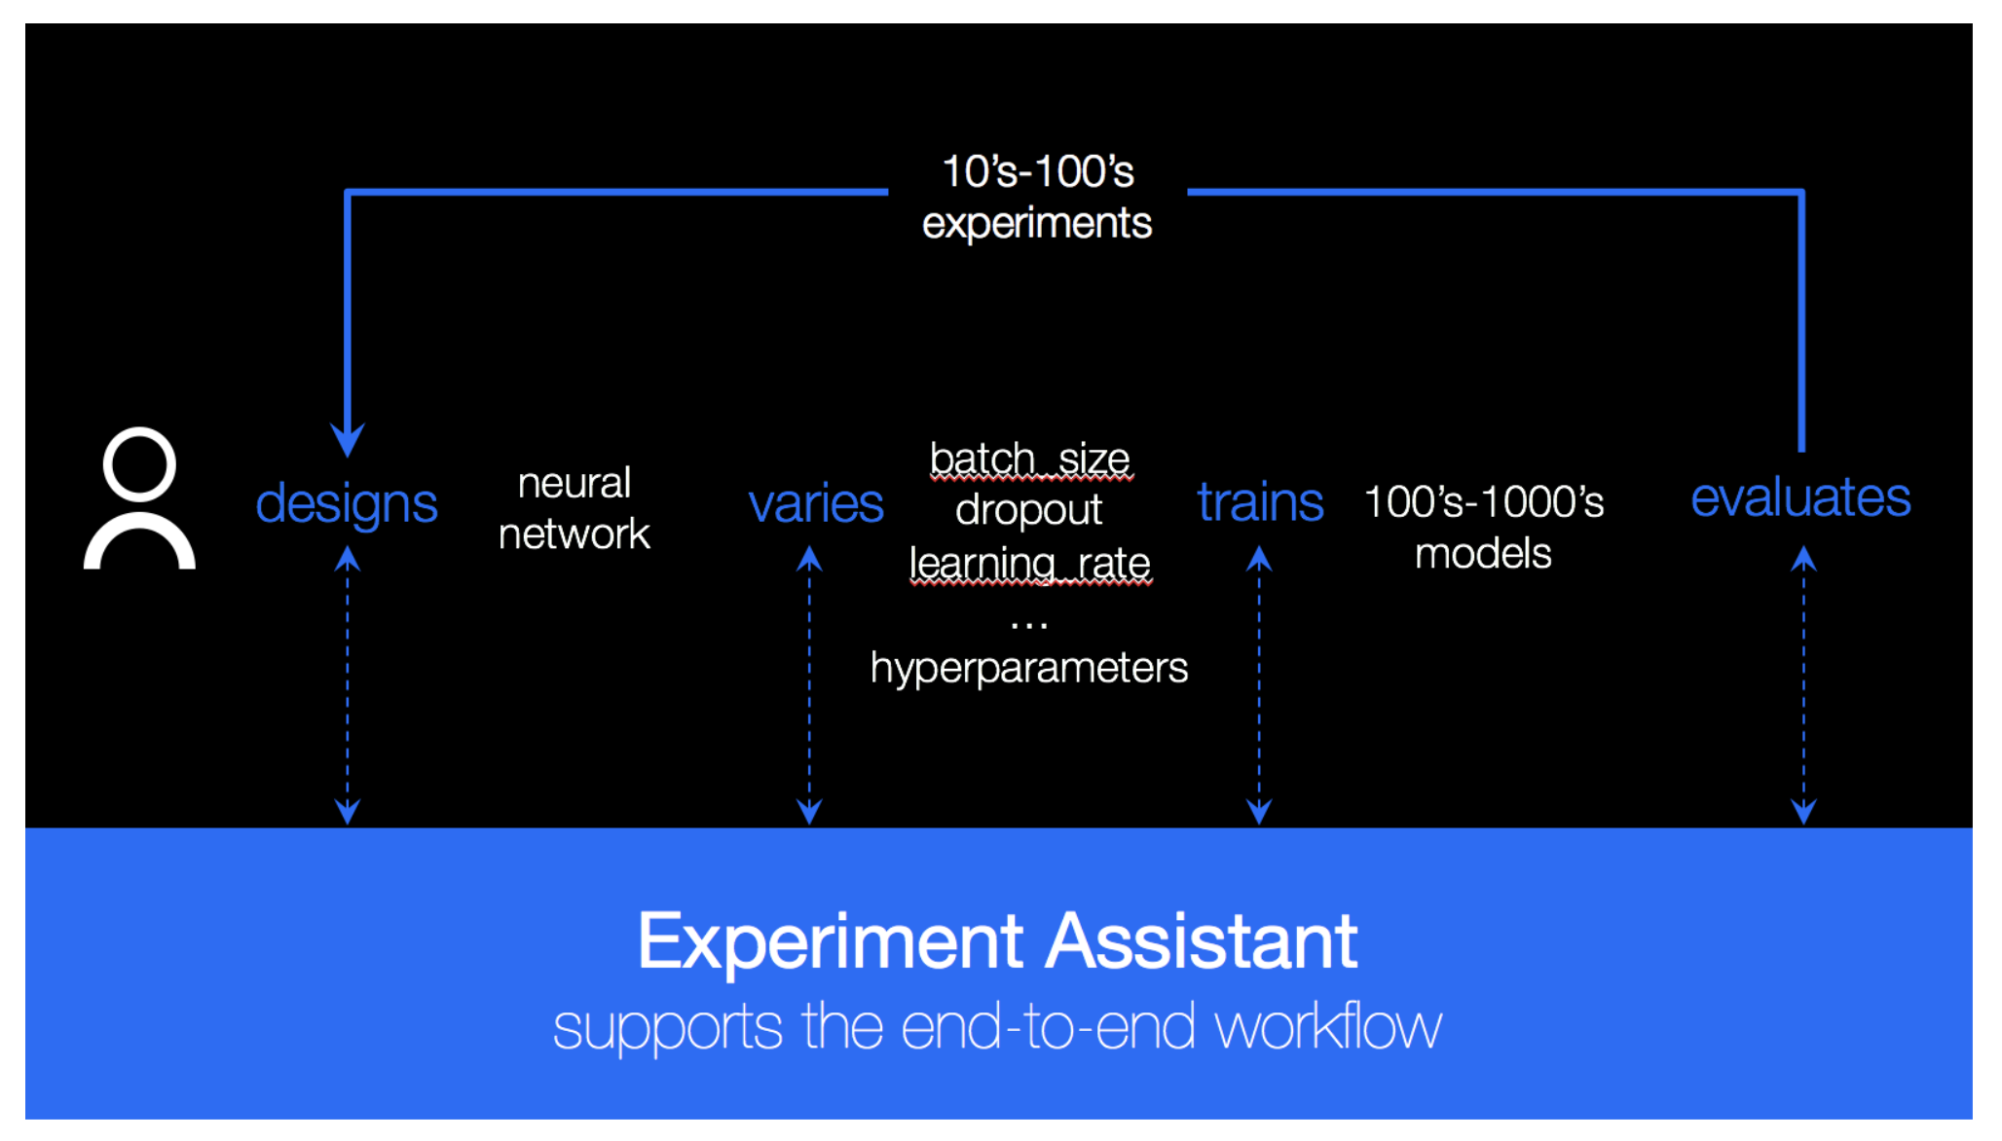

Slide 23
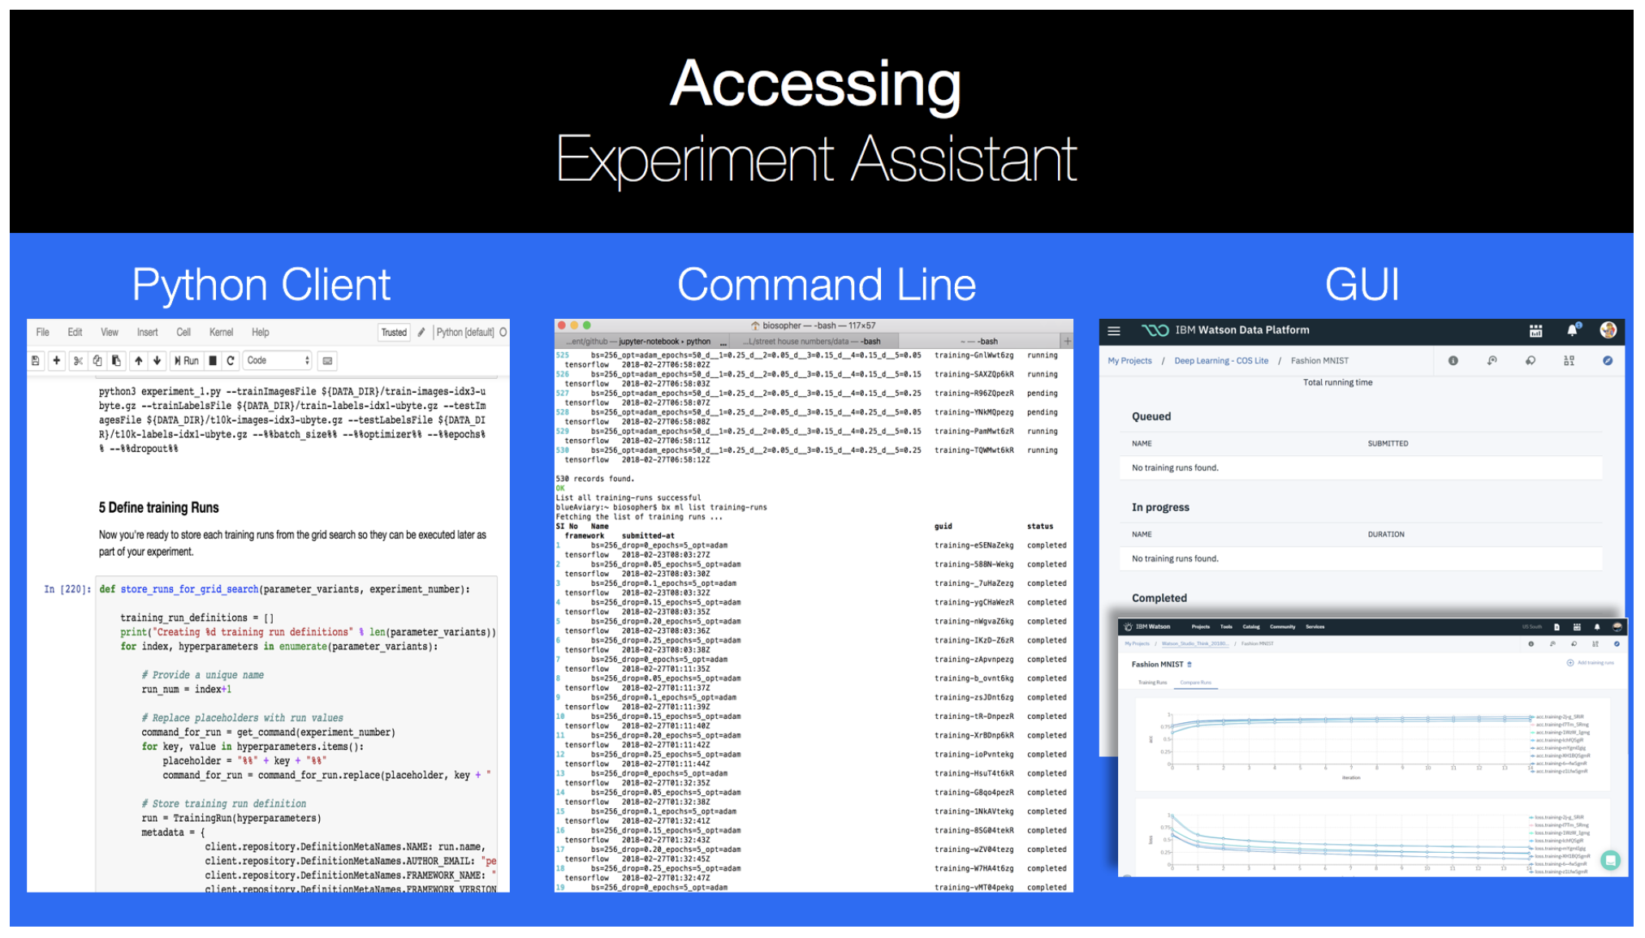

Slide 25
Fabric for Deep Learning (FfDL)

Slide 26
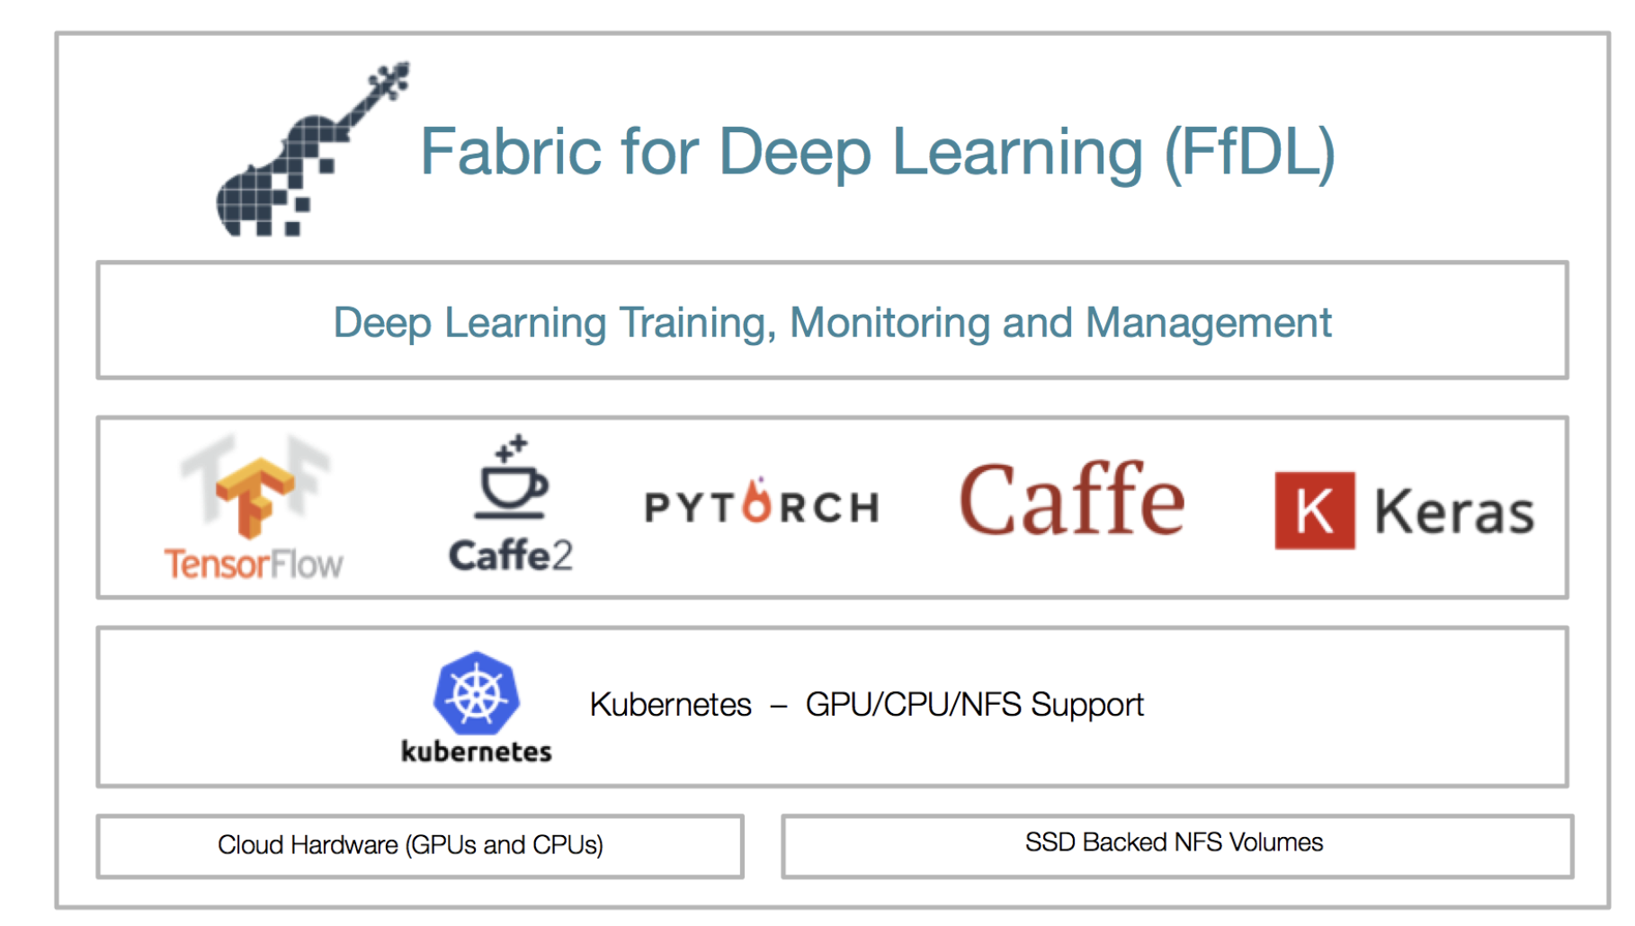

Slide 27
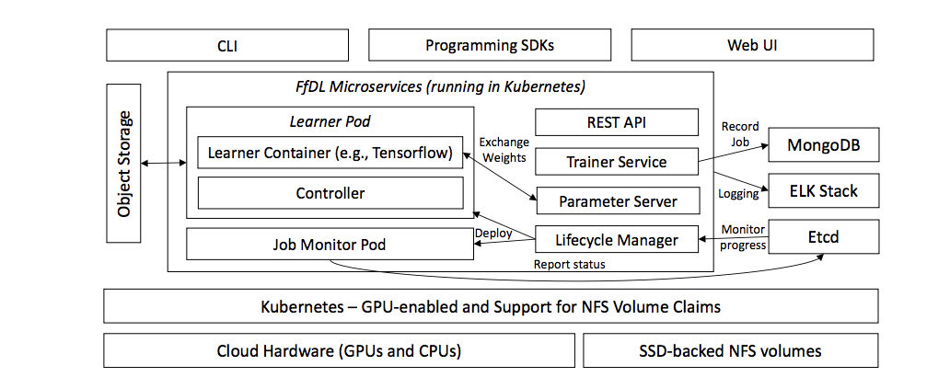

Slide 28
What is it?
Scalable Multi-Framework Multi-Tenant Lifecycle Management of Deep Learning Training Jobs

Slide 29
Training Job
efficient, fair, and secure job resource allocation at scale
raining job is a set of interconnected Kubernetes pods, each containing one or more Docker containers. Jobs can be single node or distributed, and can co-ordinate using a peer-to-peer overlay network (for Caffe2) or using a parameter server (e.g., Caffe, Torch).

Slide 30
Why?
Private Cloud services
Showcase Watson Studio
Continue embrace of Open Source
Flexiblity future frameworks while providing cross framework functionalities

Slide 31
Architecture

Slide 32
Kubernetes

Slide 33
Kubernetes
Extends Kubernetes for GPUs
Finds and provisions nodes that satisfy LCM requirements
Manages container cluster of GPU-enabled machines
Restart microservices on crash
Reports health of microservices

Slide 34
REST API

Slide 35
REST API
Handles all incoming requests
Acts as proxy to the lower-level gRPC Trainer service.
Load-balances requests
Handles authentication.

Slide 36
Trainer Service

Slide 37
Trainer Service
Admits training job requests
Stores metadata, logs, test data, and model config in MongoDB
Extracts training data from Learner Pod
Initiates job deployment, halting and termination
Assigns identifier to each job
Used by all other components to track jobs
Also used for billing purposes

Slide 38
Lifecycle Manager (LCM)

Slide 39
Lifecycle Manager (LCM)
Determines learner pods, parameter servers, and interconnections among them Requests the set of required resources
Calls on Kubernetes for deployment
A training job is a set of interconnected Kubernetes pods, each containing one or more Docker containers.

Slide 40
Learner Pod

Slide 41
Learner Pod
Executes user’s model in isolated container(s)
Input data and output results stored on shared fs

Slide 42
DBs

Slide 43
DBs
Report the progress and status of training job (etcd)
Provide checkpoint on restart (etcd)
Pause training job (etcd, thru Lifecycle Manager)
Calls on Kubernetes for deployment
A training job is a set of interconnected Kubernetes pods, each containing one or more Docker containers.

Slide 44
Object Storage

Slide 45
Object Storage
Stores
Model Definitions
Training Data
Trained Models

Slide 46
Interfaces

Slide 47
Interfaces

Slide 48
Demonstration

Slide 49
The End

Slide 50
Q&A

Slide 51
Thank You
Nick Acosta
Developer Advocate
—
nacosta@us.ibm.com
github.com/PubChimps

